Slide 1
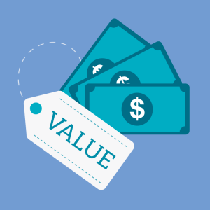
TOPIC 4: PRICE
https://www.b2binternational.com/publications/pricing-strategy-name-your-price/

Slide 2
What is price?
Narrow definition: amount of money charged for a product or service.
Only element of marketing mix that reflects revenue – other 3 Ps represent cost.
Consumers’ point of view:
Price is that which is given up in an exchange to acquire a good or service (money + time lost while waiting for good or service).
Represents perceived value (based on expected satisfaction from using product/obtaining the service, relative to the sacrifices to obtain the product or service).

Slide 3
What is price?
Marketers’ point of view:
Revenue - The price charged to customers multiplied by the number of units sold.
Profit - Revenue minus expenses (costs).
Important to set the “right” price in order to keep customers satisfied and allow the organization to make sufficient profits.
What is the right price? Watch this video to understand what happens if the price is not the right price. http://www.youtube.com/watch?v=dKfAuaspFdQ

Slide 4
How to prevent costly pricing mistakes
Set proper and relevant pricing goals (objectives) and sub-objectives
Select the most appropriate pricing strategies for new products and revise these objectives as product moves through PLC
Adjust prices using appropriate pricing tactics

Slide 5
Setting pricing objectives (goals)
Pricing objectives can be divided into three main categories:
profit-oriented objectives
sales-oriented objectives
status quo objectives

Slide 6
Each pricing objective has sub-objectives
Profit-Oriented
Profit
Maximization
Satisfactory
Profits
Target
ROI
Status Quo
Sales-Oriented
Keep
prices in line
with
competition
Market
Share
Sales Maximization

Slide 7
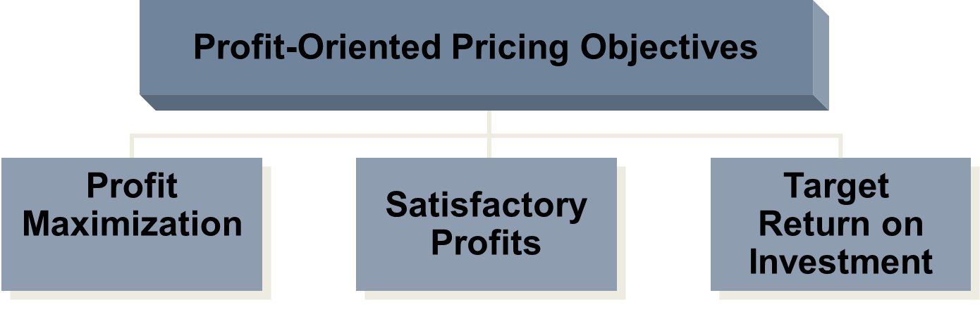
Profit-oriented pricing objectives
Setting prices so that total revenue is as large as possible relative to total costs.
ROI = Net profit after taxes divided by total assets.

Slide 8
Profit-oriented pricing objectives
Organizations all try to make as much profit as possible
Revenue = price x units sold
Profit = revenue minus cost
Profit maximization: Maximize profits, Satisfactory profits, Target return on investment
Maximize profits: Setting prices so that total revenue is as large as possible relative to total costs
Requires a mathematic model to predict sales and profits, which is very difficult to do accurately
Target ROI: Wants to reach a particular level of profit by using price to get sales that produce a certain profit per unit to get a preset return on the investment
Satisfactory profit: Not necessarily highest profit

Slide 9
Sales-oriented pricing objectives
Sales-Oriented Pricing Objectives
Market
Share
Sales
Maximization
MS = A company’s product sales as a percentage of total sales for that industry.
Increase/maintain market share
Short-term objective to maximize sales
Ignores profits, competition, and the marketing environment
Often used to sell off excess inventory

Slide 10
Status quo pricing objectives
Status Quo Pricing Objectives
Maintain
existing
prices
Meet
competition’s
prices
Not really different sub-objectives (focus on prices in line with competition)
Requires little planning
Essentially a passive policy

Slide 11
Deciding on a general pricing strategy
Pricing strategies can be broadly divided into three categories:
Customer value-based pricing
Cost-based pricing
Competition-based pricing

Slide 12
Customer value-based pricing
Value-based pricing ignores competitive prices and costs, but is based on how “valuable” product is to consumer, i.e. what the customer is willing to pay for the product based on his needs, preferences and perceptions. Is it “worth the price”?
Sets the ceiling above which customers will not buy the product - price is considered too high.
Note that “acceptable” or “good value” does not mean lowest price, e.g. a Steinway piano is very expensive, but is still perceived as providing “good” value for money.
Difficult to accurately set prices based on value perceptions. Benefits such as image resulting from owning the brand or product, satisfaction, etc derived from a product, is more subjective than measuring costs.

Slide 13
Two types of customer value-based pricing
Good-value pricing - product is priced in line with the quality of the product or service. Price has to be considered as “fair” in exchange for what customer gets.
E.g. Ryanair offers very low prices, but also little added value. Passenger has to pay for all the extras, such as bag check in, food & beverages, entertainment, etc. Many consumers regard this as a “fair price for what you get”.
Value-added pricing - Value-added features and services are added to a product in order to differentiate the offering from competitors, e.g. airline charging higher prices, but includes “extras” in the offer. Some consumers are willing to pay the higher price to get all the “extras”.

Slide 14
Cost-based pricing
Costs set the “floor” for the price.
Costs include variable costs and fixed costs.

Slide 15
Competition-based pricing
Setting prices based on competitors’ strategies, costs, prices and offerings.
If organization wants to set its prices higher than competition, it has to offer something extra that is valued by the customer. Otherwise customer is likely to buy from competition.

Slide 16
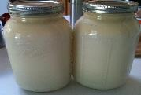
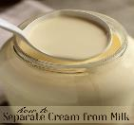

Pricing new products
Generally three strategies for setting prices on new products.
Price skimming
Penetration pricing
Status quo pricing (also called competitor pricing)
https://steemit.com/recipe/@reddust/how-to-make-butter-from-raw-milk-cream
https://www.theprairiehomestead.com/2015/03/separate-cream-from-milk.html

Slide 17
Price skimming
Strategy of charging a relatively high price during the launch of a new product and then lowering the price over time as demand declines and competitor products enter the market.
Usually a shorter term strategy suitable in case of unique product, technological breakthrough, or when there is little competition.
Aimed at innovators who like to try out new things.
High price might help to quickly recover product development costs and heavy promotional costs.
However, high price might limit growth of demand for the product and this can give competitors more time to develop alternative products.

Slide 18
Example of price skimming
Marketers of electronic products like mobile phones, typically use price skimming. When a brand e.g. Apple or Samsung, brings a new model with new features on the market, the price is usually quite high.
When competitors start offering products with similar features, the prices on the Apple or Samsung products start to decline.

Slide 19
Penetration pricing
Strategy of charging a relatively low price during the launch of a new product with the aim of quickly gaining market share.
Low price may discourage competition from market entry.
However, it might require facilities that allow for large production volumes. Out-of-stock situations might result in unhappy customers.
Selling at low prices means lower profit per unit and more units sold to cover costs.
It is difficult to raise prices once competitors have entered market.

Slide 20
Status quo pricing
Strategy of setting prices in line with competitors’ prices.
Often used for product line extensions.
Simple method, but risky as it may ignore demand and cost.
If based on competitors prices, may make costly mistakes as organization does not know objectives, cost structures, etc. of competitors.

Slide 21
Activity: Pricing new products
A farmer is producing high quality vegetables for the fresh produce market. His two daughters have managed to produce genetically alter and produce chocolate-flavoured broccoli. Although their broccoli has a chocolate taste, it still has all the health benefits of ordinary broccoli and looks like normal broccoli. The family is wondering which of the three pricing strategies would be the best option and you have to advise them.
On the one hand, they want to quickly recover the development costs of around 10 000 euro. But maybe, they should rather try to penetrate the market as quickly as possible before competitors also start producing a similar product. At this stage “regular” broccoli sells at around 3 euro per big bunch.

Slide 22
Activity: Pricing strategies
Consider the information in the following link and identify the factors that can influence the setting of the price for the new broccoli.
https://www.tutor2u.net/business/reference/pricing-factors-to-consider-when-setting-price
Evaluate the use of each of the pricing strategies for new products (skimming or penetration or status quo), motivating why or why not the strategy should be chosen.
Also suggest a selling price per kilo for the new product.
Will supply and demand affect the price? If so, how?

Slide 23
Activity: Pricing new products
Watch the video below and comment on the chosen pricing strategy.
https://www.youtube.com/watch?v=XBmWEduod5k

Slide 24
Pricing tactics: Psychological influences on price perceptions
How should prices be displayed?
https://www.nickkolenda.com/psychological-pricing-strategies/

Slide 25
Activity: Adjusting the base price through the use of pricing tactics
Tactical pricing tries to optimize price by taking short-term market dynamics, demand shifts and competitive effects into account.
Briefly describe these tactics and their purpose:
Leader pricing (loss leaders)
Price lining
Seasonal discounts
Markdowns
Coupons
Rebates

Slide 26
Thank you!
https://www.b2binternational.com/publications/pricing-strategy-name-your-price/

